Slide 1
Transport Layer Security
---EESE In-house FNV2 team
Sun Li & Liu Dapeng

Slide 2
Content
Architecture
Introduction
TLS
IVI TLS

Slide 3
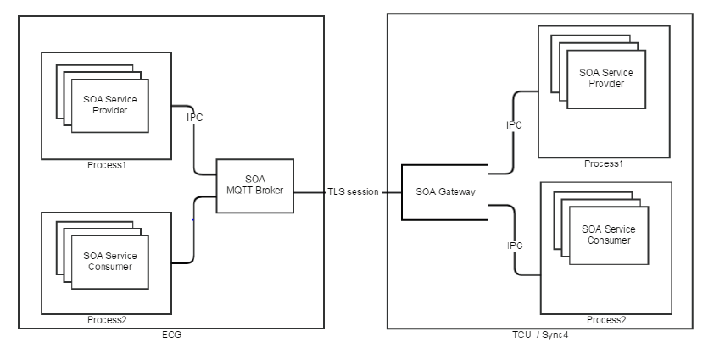
Architecture

Slide 4
Introduction
Why use TLS?
In order to curb the outside attack, ECG and its connected nodes must implement some security measures. TLS authentication is one of the implemented features.
What is TLS?
TLS is short for Transport Layer Security. It should be used to secure the TCP/IP network traffic over the in-vehicle Ethernet.
Who will use TLS?
ECG and other fast ECUs(such as SYNC, TCU or any other modules on Ethernet participating in the SOA communication with ECG).

Slide 5
Introduction
Which components help ECG support TLS?
MQTT broker
ACL configuration file
ACL built in the Mosquitto broker is a basic implementation. ACL configuration is a simple text file which could be tricky to update.
Mosquitto_auth plugin
It supports a large number of databases especially more suitable for ACL management.

Slide 6
Introduction
Which component will be responsible for TLS on IVI?
SOA gateway
SOA gateway will establish a single TLS session on behalf of all the clients.
Certificate
key management
TLS RSA key pair

Slide 7
TLS
Version
TLS v1.2
TLS Cipher suite selections
TLS_ECDHE_RSA_WITH_AES_256_CBC_SHA384_P384
TLS_ECDHE_RSA_WITH_AES_128_CBC_SHA256_P256
TLS_ECDHE_RSA_WITH_AES_256_CBC_SHA_P384
TLS_ECDHE_RSA_WITH_AES_128_CBC_SHA_P256

Slide 8
TLS
TLS digital certificate
X.509
RSA-2048 key
Sha256

Slide 9
TLS
Key storage and management
ECG
|-- RSA-2048 key pair
| |-- ECG_SOA_Auth_RSA-2048_cert
| `-- ECG_SOA_Auth_RSA-2048_priv_key
|-- SYNC_SOA_CA_RSA-cert
`-- TCU_SOA_CA_RSA-cert
SYNC
|-- RSA-2048 key pair
| |-- SYNC_SOA_Auth_RSA-2048_cert
| `-- SYNC_SOA_Auth_RSA-2048_priv_key
`-- ECG_SOA_CA_RSA-cert
TCU
|-- RSA-2048 key pair
| |-- TCU_SOA_Auth_RSA-2048_cert
| `-- TCU_SOA_Auth_RSA-2048_priv_key
`-- ECG_SOA_CA_RSA-cert

Slide 10
IVI TLS
RSA-2048 key pair
SYNC_SOA_Auth_RSA-2048_cert
SYNC_SOA_Auth_RSA-2048_priv_key
ECG_SOA_CA_RSA-cert
SOA Gateway contains secure TLS connection
Headers contains all the paths to enable a secure TLS connection
CERT_ECG_SOA_TLS_CA - ECG CA Certification location
CERT_CLIENT_SOA_TLS_PUBLIC - client public TLS certificate location
KEY_CLIENT_SOA_TLS_PRIVATE - client private TLS key location
key-store library what we link to get paths so SOA Gateway can read certificates and keys

Slide 11
Scope & Next Steps
Global & Local Security Team(Local contact: Huang Eric)
Clarifying the requirement and corresponding specification;
Providing keys and certifcaes
Providing TLC component libraries
Providing the correct TLS format for SYNC+;
REC & Desay Team
Integrate keys and certificates which will be used in TLS session on DuerOS
implement the APIs of write /read the certificates and keys.
FNA (SOA Gateway) Team
Provide the APIs and Libraries of SOA gateway and make sure the SOA Gateway can access the certificates and keys on target.

Slide 12
Thank you

